Slide 1

CSE- 208
Algorithms Lab
Lab: 11
Dynamic Programming: LCS
Fahad Ahmed
Lecturer, Dept. of CSE
E-mail: fahadahmed@uap-bd.edu

Slide 2
Task-11
Problem:
Implement the following algorithm using Dynamic Programming:
Longest Common Subsequence (LCS)

Slide 3


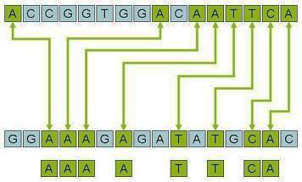
Longest Common Subsequence (LCS)

Slide 4
Subsequence
A subsequence is a sequence that can be derived from another sequence by deleting some or no elements without changing the order of the remaining elements.
For example, the sequence {A, B, D} is a subsequence of {A, B, C, D, E, F} obtained after removal of elements C, E, and F.

Slide 5
Sub-sequences vs. Substring
Subsequences can contain consecutive elements which were not consecutive in the original sequence.
Substring contains consecutive elements which were also consecutive in the original sequence.
Example:
“gramm” is both subsequence and substring of “programming”
“gammg” is a subsequence of “programming” but not substring.
All substrings are subsequences but all subsequences are not substrings.

Slide 6
Sub-sequences vs. Substring
 | Subarray | Substring | Subsequence | Subset
Contiguous | Yes | Yes | No | No
Elements Ordered | Yes | Yes | Yes | No

Slide 7
Common subsequence
Given two sequences X and Y, a sequence Z is said to be a common subsequence of X and Y, if Z is a subsequence of both X and Y.
For example, if
X = e c d g i Y = a b c d e f g h i j
then Z is the common subsequence of X and Y.
Z = e g i ,
c d g i, ….
Longest Common Subsequence (LCS) will be c d g i that is 4 .

Slide 8
Common subsequence
Another example, if
X = babace
Y = abdace
Z is the common subsequence of X and Y.
Z = bace,
abce, ….
There can be multiple Subsequence with same length.

Slide 9
Recursive algorithm for LCS
LCS(x, y, i, j)
if x[i] = y[ j]
then c[i, j] ← LCS(x, y, i+1, j+1) + 1
else c[i, j] ← max{ LCS(x, y, i+1, j), LCS(x, y, i, j+1) }
Worst-case: x[i] ≠ y[ j], in which case the algorithm evaluates two subproblems, each with only one parameter decremented.

Slide 10
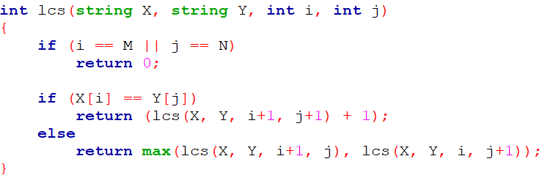
Recursive algorithm for LCS

Slide 11
DP Algorithm
Key: find out the correct order to solve the sub-problems
Total number of sub-problems: m * n
c[i–1, j–1] + 1 if x[i] = y[j],
max{c[i–1, j], c[i, j–1]} otherwise.
c[i, j] =
0
j
n
0
 |  | C(i, j)
i
m

Slide 12
DP Algorithm
LCS-Length(X, Y)
1. m = length(X) // get the # of symbols in X
2. n = length(Y) // get the # of symbols in Y
3. for i = 1 to m c[i,0] = 0 // special case: Y[0]
4. for j = 1 to n c[0,j] = 0 // special case: X[0]
5. for i = 1 to m // for all X[i]
6. for j = 1 to n // for all Y[j]
7. if ( X[i] == Y[j])
8. c[i,j] = c[i-1,j-1] + 1
9. else c[i,j] = max( c[i-1,j], c[i,j-1] )
10. return c

Slide 13
LCS Solution Bottom Up : Tabulation
We’ll see how LCS algorithm works on the following example:
X = ABCB
Y = BDCAB
What is the LCS of X and Y?
LCS(X, Y) = BCB
X = A B C B
Y = B D C A B

Slide 14
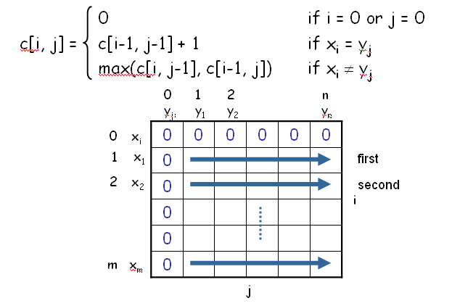
Computing the Length of the LCS

Slide 15
LCS Example (0)
ABCB
BDCAB
j 0 1 2 3 4 5
i
Y[j]
B
D
C
A
B
0
X[i]
A
1
2
B
3
C
4
B
X = ABCB; m = |X| = 4
Y = BDCAB; n = |Y| = 5
Allocate array c[5,6]

Slide 16
LCS Example (1)
ABCB
BDCAB
j 0 1 2 3 4 5
i
Y[j]
B
D
C
A
B
0
X[i]
0
0
0
0
0
0
A
1
0
2
B
0
3
C
0
4
B
0
for i = 1 to m c[i,0] = 0
for j = 1 to n c[0,j] = 0

Slide 17
LCS Example (2)
ABCB
BDCAB
j 0 1 2 3 4 5
i
Y[j]
B
D
C
A
B
0
X[i]
0
0
0
0
0
0
A
1
0
0
2
B
0
3
C
0
4
B
0
if ( X_{i} == Y_{j} )
c[i,j] = c[i-1,j-1] + 1
else c[i,j] = max( c[i-1,j], c[i,j-1] )

Slide 18
LCS Example (3)
ABCB
BDCAB
j 0 1 2 3 4 5
i
Y[j]
B
D
C
A
B
0
X[i]
0
0
0
0
0
0
A
1
0
0
0
0
2
B
0
3
C
0
4
B
0
if ( X_{i} == Y_{j} )
c[i,j] = c[i-1,j-1] + 1
else c[i,j] = max( c[i-1,j], c[i,j-1] )

Slide 19
LCS Example (4)
ABCB
BDCAB
j 0 1 2 3 4 5
i
Y[j]
B
D
C
A
B
0
X[i]
0
0
0
0
0
0
A
1
0
0
0
0
1
2
B
0
3
C
0
4
B
0
if ( X_{i} == Y_{j} )
c[i,j] = c[i-1,j-1] + 1
else c[i,j] = max( c[i-1,j], c[i,j-1] )

Slide 20
LCS Example (5)
ABCB
BDCAB
j 0 1 2 3 4 5
i
Y[j]
B
D
C
A
B
0
X[i]
0
0
0
0
0
0
A
1
0
0
0
0
1
1
2
B
0
3
C
0
4
B
0
if ( X_{i} == Y_{j} )
c[i,j] = c[i-1,j-1] + 1
else c[i,j] = max( c[i-1,j], c[i,j-1] )

Slide 21
LCS Example (6)
ABCB
BDCAB
j 0 1 2 3 4 5
i
Y[j]
B
D
C
A
B
0
X[i]
0
0
0
0
0
0
A
1
0
0
0
0
1
1
2
B
0
1
3
C
0
4
B
0
if ( X_{i} == Y_{j} )
c[i,j] = c[i-1,j-1] + 1
else c[i,j] = max( c[i-1,j], c[i,j-1] )

Slide 22
LCS Example (7)
ABCB
BDCAB
j 0 1 2 3 4 5
i
Y[j]
B
D
C
A
B
0
X[i]
0
0
0
0
0
0
A
1
0
0
0
0
1
1
2
B
0
1
1
1
1
3
C
0
4
B
0
if ( X_{i} == Y_{j} )
c[i,j] = c[i-1,j-1] + 1
else c[i,j] = max( c[i-1,j], c[i,j-1] )

Slide 23
LCS Example (8)
ABCB
BDCAB
j 0 1 2 3 4 5
i
Y[j]
B
D
C
A
B
0
X[i]
0
0
0
0
0
0
A
1
0
0
0
0
1
1
2
B
0
1
1
1
1
2
3
C
0
4
B
0
if ( X_{i} == Y_{j} )
c[i,j] = c[i-1,j-1] + 1
else c[i,j] = max( c[i-1,j], c[i,j-1] )

Slide 24
LCS Example (9)
ABCB
BDCAB
j 0 1 2 3 4 5
i
Y[j]
B
D
C
A
B
0
X[i]
0
0
0
0
0
0
A
1
0
0
0
0
1
1
2
B
0
1
1
1
1
2
3
C
0
1
1
4
B
0
if ( X_{i} == Y_{j} )
c[i,j] = c[i-1,j-1] + 1
else c[i,j] = max( c[i-1,j], c[i,j-1] )

Slide 25
LCS Example (10)
ABCB
BDCAB
j 0 1 2 3 4 5
i
Y[j]
B
D
C
A
B
0
X[i]
0
0
0
0
0
0
A
1
0
0
0
0
1
1
2
B
0
1
1
1
1
2
3
C
0
1
1
2
4
B
0
if ( X_{i} == Y_{j} )
c[i,j] = c[i-1,j-1] + 1
else c[i,j] = max( c[i-1,j], c[i,j-1] )

Slide 26
LCS Example (11)
ABCB
BDCAB
j 0 1 2 3 4 5
i
Y[j]
B
D
C
A
B
0
X[i]
0
0
0
0
0
0
A
1
0
0
0
0
1
1
2
B
0
1
1
1
1
2
3
C
0
1
1
2
2
2
4
B
0
if ( X_{i} == Y_{j} )
c[i,j] = c[i-1,j-1] + 1
else c[i,j] = max( c[i-1,j], c[i,j-1] )

Slide 27
LCS Example (12)
ABCB
BDCAB
j 0 1 2 3 4 5
i
Y[j]
B
D
C
A
B
0
X[i]
0
0
0
0
0
0
A
1
0
0
0
0
1
1
2
B
0
1
1
1
1
2
3
C
0
1
1
2
2
2
4
B
0
1
if ( X_{i} == Y_{j} )
c[i,j] = c[i-1,j-1] + 1
else c[i,j] = max( c[i-1,j], c[i,j-1] )

Slide 28
LCS Example (13)
ABCB
BDCAB
j 0 1 2 3 4 5
i
Y[j]
B
D
C
A
B
0
X[i]
0
0
0
0
0
0
A
1
0
0
0
0
1
1
2
B
0
1
1
1
1
2
3
C
0
1
1
2
2
2
4
B
0
1
1
2
2
if ( X_{i} == Y_{j} )
c[i,j] = c[i-1,j-1] + 1
else c[i,j] = max( c[i-1,j], c[i,j-1] )

Slide 29
LCS Example (14)
ABCB
BDCAB
j 0 1 2 3 4 5
i
Y[j]
B
D
C
A
B
0
X[i]
0
0
0
0
0
0
A
1
0
0
0
0
1
1
2
B
0
1
1
1
1
2
3
C
0
1
1
2
2
2
4
B
3
0
1
1
2
2
if ( X_{i} == Y_{j} )
c[i,j] = c[i-1,j-1] + 1
else c[i,j] = max( c[i-1,j], c[i,j-1] )

Slide 30
LCS Algorithm Running Time
LCS algorithm calculates the values of each entry of the array c[m,n]
So what is the running time?
Time Complexity: We can see that the time complexity of the DP and memoization approach is reduced to O(m*n), where m and n are the lengths of the given strings.
since each c[i,j] is calculated in constant time, and there are m*n elements in the array

Slide 31
How to find actual LCS
The algorithm just found the length of LCS, but not LCS itself.
How to find the actual LCS?
For each c[i,j] we know how it was acquired:
A match happens only when the first equation is taken
So we can start from c[m,n] and go backwards, remember x[i] whenever c[i,j] = c[i-1, j-1]+1.
2
2
For example, here
c[i,j] = c[i-1,j-1] +1 = 2+1=3
2
3

Slide 32
Finding LCS
j 0 1 2 3 4 5
i
Y[j]
B
D
C
A
B
0
X[i]
0
0
0
0
0
0
A
1
0
0
0
0
1
1
2
B
0
1
1
1
1
2
3
C
0
1
1
2
2
2
4
B
3
0
1
1
2
2
Time for trace back: O(m+n).

Slide 33
Finding LCS (2)
j 0 1 2 3 4 5
i
Y[j]
B
D
C
A
B
0
X[i]
0
0
0
0
0
0
A
1
0
0
0
0
1
1
2
B
0
1
1
1
1
2
3
C
0
1
1
2
2
2
4
B
3
0
1
1
2
2
LCS (reversed order):
B
C
B
B C B
(this string turned out to be a palindrome)
LCS (straight order):

Slide 34
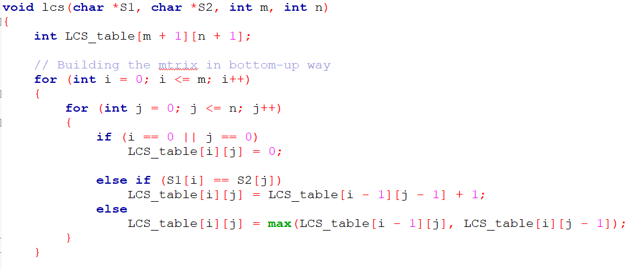
LCS Using Memorization: Bottom-UP

Slide 35
Additional Problem Based on DP
Longest Increasing Subsequence
Edit Distance
Minimum Partition
Ways to Cover a Distance
Longest Path In Matrix
Subset Sum Problem
Optimal Strategy for a Game
Boolean Parenthesization Problem
Shortest Common Supersequence
Matrix Chain Multiplication
Partition problem
Word Break Problem
Maximal Product when Cutting Rope
Dice Throw Problem
Box Stacking
Egg Dropping Puzzle

Slide 36
Lab Test: 30 Min , 20 marks
Problem -1
Problem -2
Problem -3

Slide 37

Thanks to All

